Slide 1







Physics-Guided Discovery of Highly Nonlinear Parametric Partial Differential Equations
Presenter: Yingtao Luo (PhD student at Carnegie Mellon University)
Authors: Yingtao Luo, Qiang Liu, Yuntian Chen, Wenbo Hu, Tian Tian, Jun Zhu
Notes:
Hi, everyone. My name is Yingtao and I am very happy to present our paper “Physics-Guided Discovery of Highly Nonlinear Parametric Partial Differential Equations”.

Slide 2
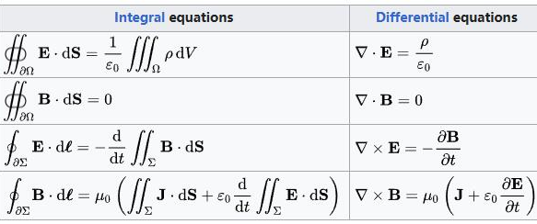




Partial Differential Equations are Ubiquitous
Maxwell’s Equations (Electromagnetism)
Convection–Diffusion Equation
Black-Scholes PDE (Finance)
Navier-Stokers Equation (Fluids)
Schrödinger Equation (Quantum)
Notes:
Over the history of modern science, mathematical equations are widely used for explaining various phenomena, and partial differential equations are one ubiquitous kind of equations scientists love to use. For example, we have the Maxwell’s equations that describe how electric and magnetic fields interact and propagate, the Navier-Stokes equations that describe the motion of fluids in a wide range of areas from aerodynamics to weather prediction. We have black-Scholes PDE for option pricing, Schrodinger equation for quantum physics, and etc.

Slide 3
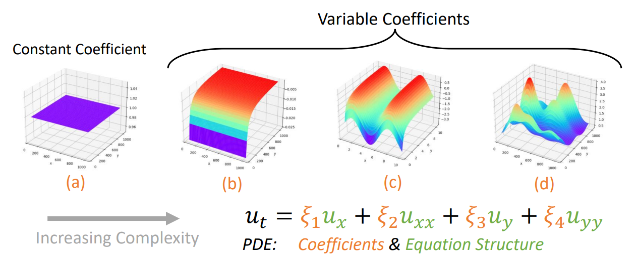
PDEs with Variable Coefficients
(a) a constant value 1, (b) −1/𝑥, (c) −1/𝑥 + sin𝑦, (d) complex coefficient field
Notes:
A PDE usually consists of both coefficients and equation structure. In this example, we illustrate two different kinds of PDEs: the ones with constant coefficient over space and time, and the ones with variable coefficients. You can see that from bracket a to bracket d, which is from left to right, the complexity of coefficients is increasing. In the extreme case of d, where the distribution of coefficient is highly nonlinear, discovering such a PDE and understanding what is the governing dynamics there can be painful even for a highly trained scientist.

Slide 4
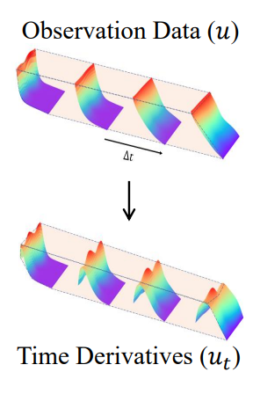
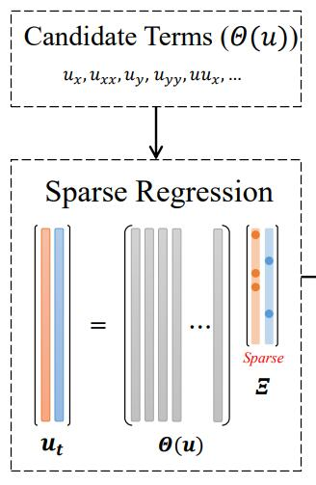
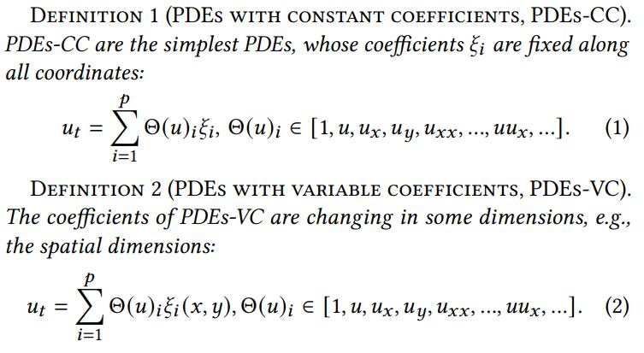
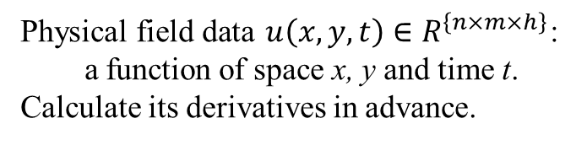
Overall Pipeline of PDE Discovery
Physical field data $u\left(x,y,t\right)∈R^{\left\{n×m×h\right\}}$:
a function of space x, y and time t.
Calculate its derivatives in advance.
Notes:
Luckily, people have been using data-driven approaches for PDE discovery. Basically, we can use any differentiation method to create the derivatives of the original physical field u with respect to space and time. Here we assume that the coefficient field is only a function of space, which remains the same for any given time. We assume that the time derivative always presents in the PDE. So, with all the other candidate terms,

Slide 5
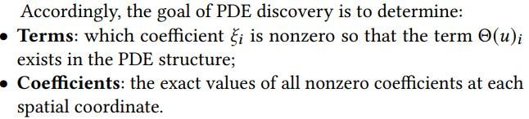

Objective of Parametric PDE Discovery
Sparse Regression (filter irrelevant terms):
Independent coefficient estimation across space
Notes:
sparse regression is performed to filter irrelevant terms and determine the coefficients. So, the name of the game is to find terms and coefficients simultaneously. Usually, such a regression is performed independently for each spatial coordinate. But a very straightforward question will be, if the coefficients are not constant values, how can we make sure the equation found by the sparse regression can generalize well? Because as you see, given any equation terms, we can literally always find a coefficient field that perfectly fits the training data, if not the test data. The challenge of generalization lies in the understanding and interpretability of the discovered PDE terms and coefficients.

Slide 6
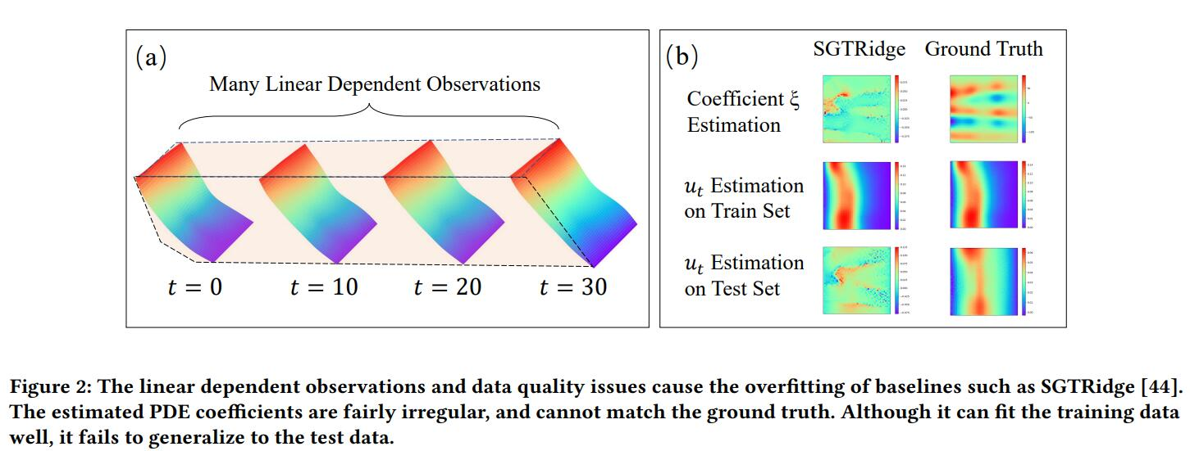
The Challenge of Highly Nonlinear Coefficients
Notes:
Here, we put up an example to illustrate the importance of PDE generalization and interpretability. As shown by subfigure (a), if the physical field is not changing very rapidly, there will be many linearly dependent observations that may cause a underdetermined system. When we train a sparse regression model that is spatially independent, the overfitting issue can be very severe. In subfigure (b), we use a prior work SGTRidge as an example. We find that even if we know the correct PDE terms, the coefficient estimation can causing overfitting of the sparse regression: The estimated coefficients are fairly irregular compared to the ground truth. As a result, even though the equation can fit the time derivative on the training set perfectly, the estimation error on test set is a complete disaster. This problem is especially severe when we try to discover PDEs with complex coefficient fields and with scares and noisy data.

Slide 7
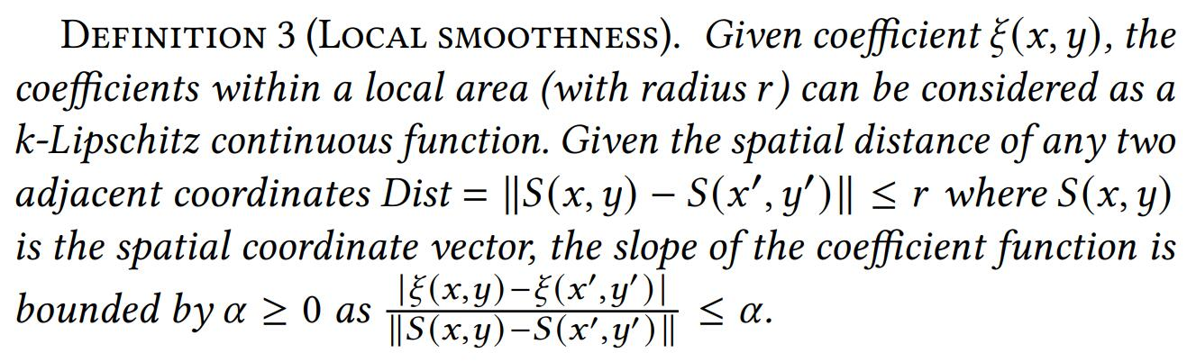
Motivation 1: Smooth Coefficient Field
Recall: Differentiation accuracy assumes smoothness as a first principle.
Scope: Most physical fields. For those with mutations or discontinuities, PDEs alone are not enough (need shock/discontinuity-capturing methods).
Notes:
To alleviate the this problem, we propose to incorporate more physics constraints to guide the discovery of governing equation. First, we introduce one of the first principles in PDE, that is the smoothness of coefficient field. A "first principle" refers to a basic assumption that cannot be deduced from any other assumption, which is the foundation of knowledge. Only in some rare situations where there are mutations and discontinuities, this assumption might be violated. But note that, in these cases, PDEs are no longer suitable for describing the phenomena any longer anyway, and we often need techniques such as shock-capturing methods to deal with them.

Slide 8
Motivation 1: Smooth Coefficient Field
Notes:
We assume that in most cases, even if the coefficient is very complex, it can still be bounded by the Lipschitz continuity.

Slide 9
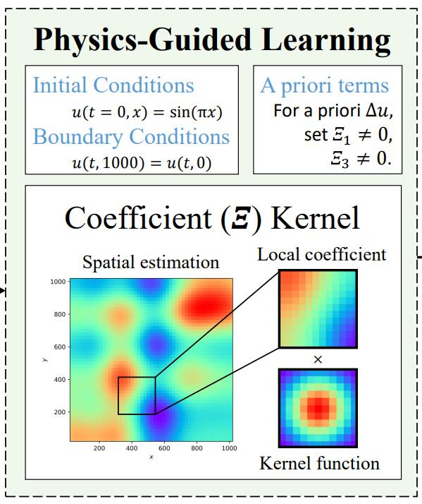
Motivation 2: Physics Knowledge & Principles
Physics Knowledge:
Initial and boundary conditions, a priori terms.
(Solve PDE using any differentiable solver and make it match the ground truth “u(x,y,t)”.)
Physics Principles:
Conservation laws, smoothness.
(Design a spatiotemporally rotation and translation invariant smoothness constraint)
Notes:
Second, we also leverage the physics knowledge and principles. Physics knowledge means the human a priori understanding or observation of the problem. Physics principles are slightly different – they hold true universally in the world.

Slide 10
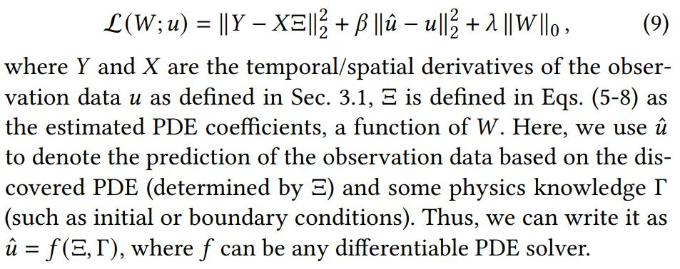
Physics-Guided Knowledge Constraint
Design a loss function with knowledge constraint:
Notes:
For physics knowledge such as initial and boundary conditions and a priori terms, we can directly add a loss term that minimizes the error of solving the PDE with respect to the physics knowledge. This can be done with any fixed differentiable PDE solver.

Slide 11
Motivation 2: Physics Knowledge & Principles
Physics Knowledge:
Initial and boundary conditions, a priori terms.
(Solve PDE using any differentiable solver and make it match the ground truth “u(x,y,t)”.)
Physics Principles:
Conservation laws, smoothness.
(Design a spatiotemporally rotation and translation invariant smoothness constraint)
Notes:
Considering the law of conservation, we propose that any optimization constraints must be invariant to spatiotemporal rotation and translation. To consider the local smoothness, instead of adding a regularization term in the loss that minimizes the differences in adjacent coefficient values, we propose a local spatial kernel in the sparse regression.

Slide 12
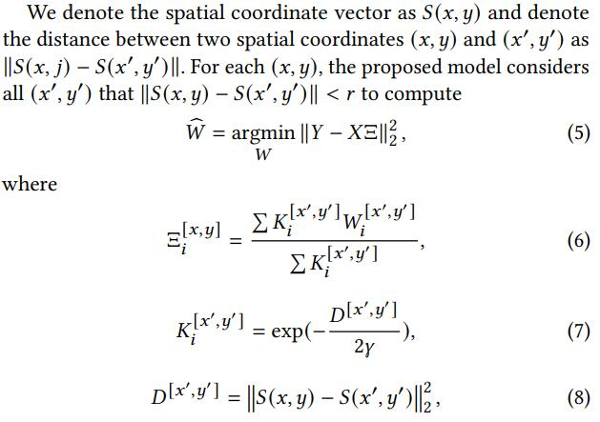
Spatial Kernel Smoothness Constraint
Notes:
Basically, we use the local kernel estimation of spatially adjacent coefficients as the regression weight to optimize the sparse regression. Therefore, the model can capture the interaction between adjacent points. The advantage of such a kernel in computational efficiency is very obvious, because we share the same RBF kernel for all the coefficient estimations. By calculating the Euclidean distance, closer coefficients will have higher influence on the estimation. There is no redundant computation of local smoothness otherwise in the loss function, if we consider for example minimizing the differences in adjacent coefficient values in the loss.

Slide 13


Complexity and Theoretical Analysis
Kernel Complexity: Linearly proportional to the size of the dataset.
(The data used for estimating each coefficient is “local”)
Estimation Error: Strictly lower than works like Adaptive-DLGA [1].
(Far-away coefficients have lower density in the kernel)
Robustness: Strictly lower than independent coefficient estimation.
For I.I.D. Gaussian noises,
which is lower than
Mesh-Free: (Kernel only calculates spatial distance. No grid is needed.)
[1] Hao Xu, et al. 2021. Deep-learning of parametric partial differential equations from sparse and noisy data.
Notes:
As a summary, the kernel complexity is only O(n) if n is the size of the dataset. We demonstrate that the local spatial kernel has a strictly lower error than previous works. Moreover, we demonstrate that as long as the noises are i.i.d. across spatial dimensions, our method has a strictly stronger robustness. Moreover, because spatial distance is used to determine the influence of an adjacent coordinate, our model is completely mesh-free.

Slide 14
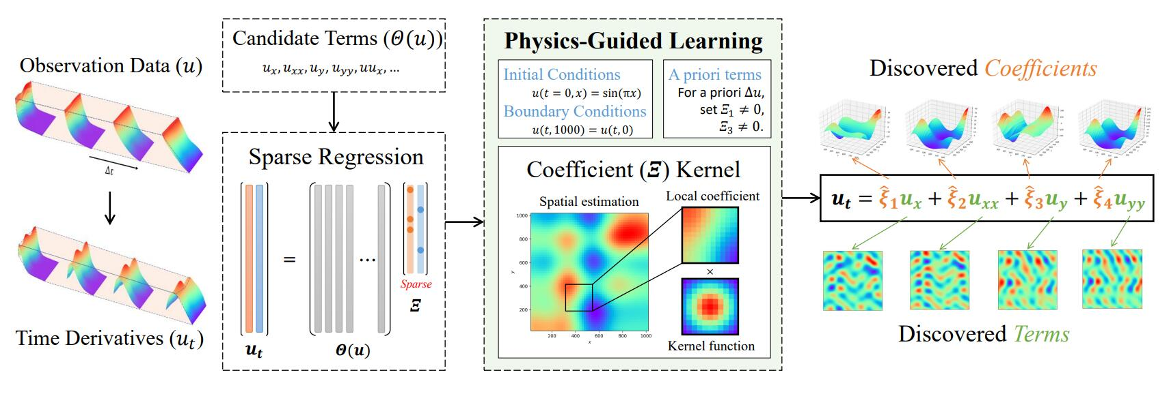
HIN-PDE Diagram
Notes:
If we put the puzzles together, the overall diagram of the proposed HIN-PDE is there. HIN stands for “highly nonlinear”.

Slide 15
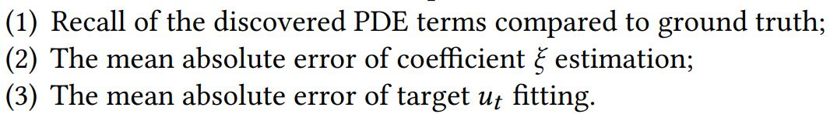
Experimental Setting
PDEs with constant coefficients (Data): The Burgers’ equation, the Korteweg-de Vries (KdV) equation, and the Chaffe-Infante equation. (Kernel is useless for them)
Parametric PDEs (Data): Five governing equations of underground seepage.
Train/Dev/Test: 30%/30%/40%.
Training Dataloader: Randomly sample 10%-20% training data (scarce & mesh-free).
Metrics:
Notes:
We conduct two kinds of experiments. For PDEs with constant coefficients, we consider Burgers’ equation, the Korteweg-de Vries (KdV) equation, and the Chaffe-Infante equation. For PDEs with variable coefficients, we consider five governing equations of underground seepage, which all have highly nonlinear coefficient fields. To mimic the situation where we only have scarce and irregularly sampled data, we randomly sample 10 to 20 percent of the data for training. We consider three metrics: …

Slide 16



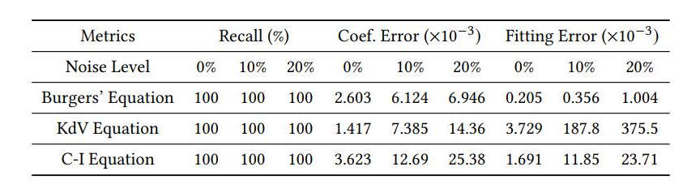
HIN-PDE discover constant coefficients accurately
Burgers’ Equation
KdV Equation
C-I Equation
Notes:
For PDEs with constant coefficients, the smoothness property of our method is meaningless. However, we do find that our method is extremely robust against noises up to even 20%, which was rarely reported in previous works.

Slide 17

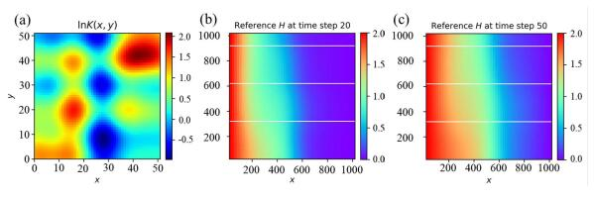
Data statistics on PDE with variable coefficients
Governing equation of underground seepage (a form of Convection–diffusion equations)
where 𝑆𝑠 denotes the specific storage; 𝐾(𝑥, 𝑦) denotes the hydraulic conductivity field; and 𝑢 denotes the hydraulic head. 𝑢 is the physical field. 𝐾 is the coefficient field as shown below.
Notes:
For PDEs with variable coefficients, the equation we select have the same terms to the convection-diffusion equations, except that the coefficient field here has a physical meaning. It represents the hydraulic conductivity field.

Slide 18
Data statistics on PDE with variable coefficients
Governing equation of underground seepage (a form of Convection–diffusion equations)
where 𝑆𝑠 denotes the specific storage; 𝐾(𝑥, 𝑦) denotes the hydraulic conductivity field; and 𝑢 denotes the hydraulic head. 𝑢 is the physical field and 𝐾 is the coefficient field.
Convection–diffusion equation is also used by PDE-Net, but its coefficient field is much simpler.
The hydraulic conductivity field 𝐾(𝑥, 𝑦) in the governing equation is set to be heterogeneous to simulate real situations, which is random fields with higher complexity.
Notes:
The same equation terms are also used by a prior work, PDE-Net. However, the coefficient field in PDE-Net is generated by a linear function and is very simple. The equations we try to discover in this paper, however, is a heterogeneous random field.

Slide 19
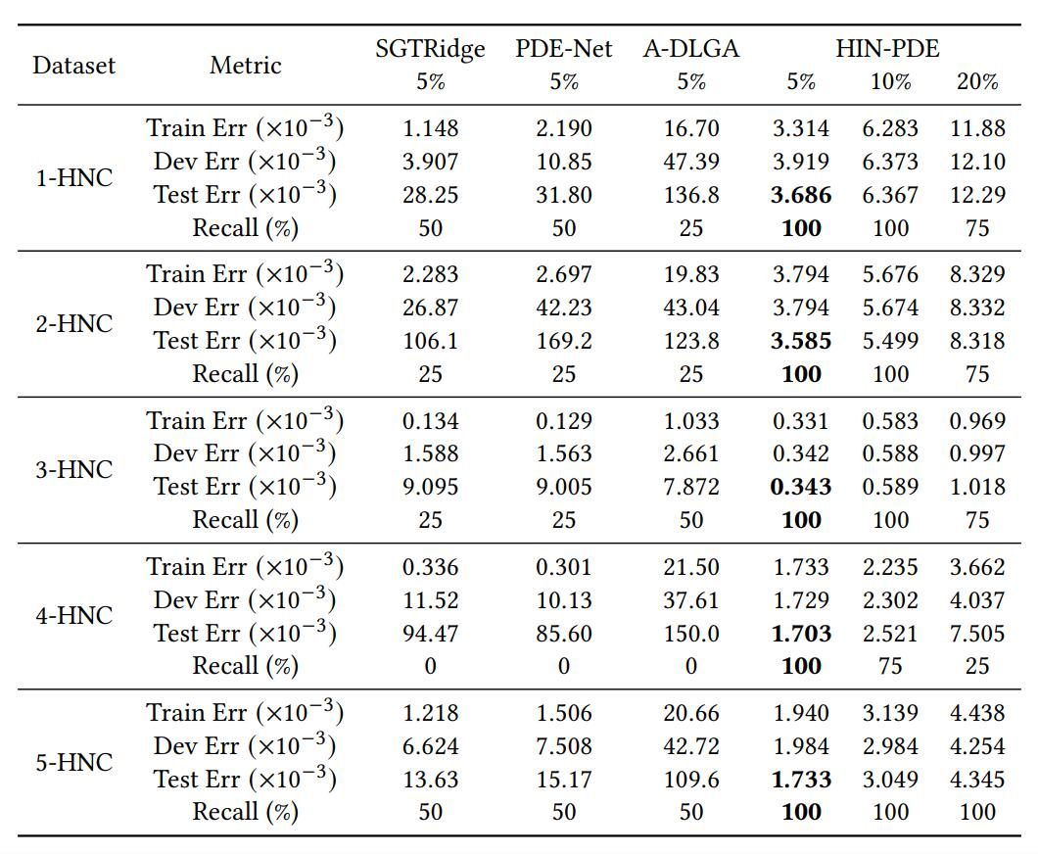

On variable coefficients
Governing equation of underground seepage as a form of parametric Convection–diffusion equations
The only method that discovers the equations with highly nonlinear coefficient correctly!
Notes:
We find that under 5% noise, our method is the only one that discovers the PDE terms correctly with small errors on both the coefficient estimation and the sparse regression target. With wrong PDEs, other methods have extremely large test regression error and coefficient estimation error.

Slide 20
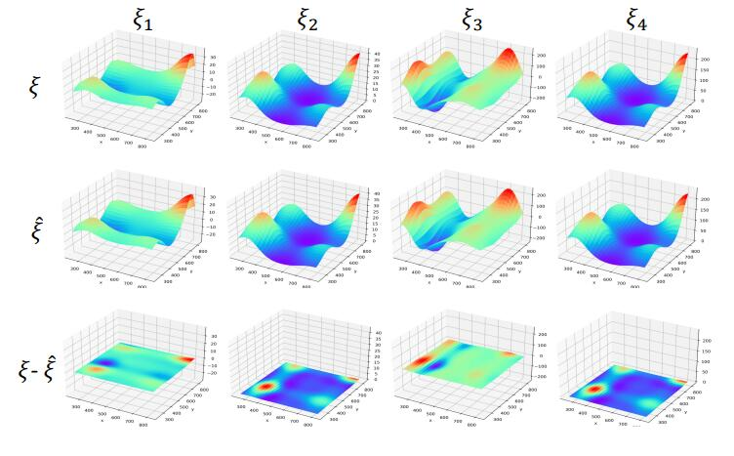
Comparison of Estimated and Ground-Truth Coefficients
Four columns represent four 𝜉_𝑖 that are nonzero in the ground-truth PDE.
The residual errors is |𝜉 − ˆ𝜉|/|𝜉| = 1%.
Notes:
There is a visualization of one of the coefficient fields discovered by our method. As one can conclude from the picture, the estimation is extremely accurate. It is not entirely surprising, because other methods do not consider any physics-guided constraints.

Slide 21

Unsolved Challenge: Correlated Similar Terms
Governing equation of underground seepage as a form of parametric Convection–diffusion equations
The incorrectly discovered PDE
If u is not changing rapidly along spatial dimension, u_x will be similar to u.
Notes:
An interesting finding from the experiment is that, our method sometimes can find equation terms that are very similar to the ground-truth. In this case, if u is not changing rapidly along spatial dimension, u_x will be very similar to u. Therefore, we find that the test error is also fairly small. This is a challenge we have not solved yet. From a pure data-driven perspective, minimizing the regression error is the only objective, thus it is difficult for machine learning alone to tackle challenges like this. This again emphasizes the importance of domain knowledge and human-in-the-loop solution.

Slide 22
A question for everyone: How many constraints are enough?
Uniqueness of the PDE
Generalization Ability
More Physics Knowledge
More Physics Principles
Higher Complexity of Problem
Lower Data Quality Requirement
Can we meet the excessive growing expectation?
Notes:
However, there is still a question lingering in my mind. We know that more physics knowledge and more physics principles are good, but can we find enough domain knowledge support to meet the excessive growing expectation of the complexity of the problems we want to solve? Since PDE discovery is essentially data-driven, can we do more about the data side to further push forward of the boundaries of problems we can solve? This is a very exciting field and hopefully in the future, we can be able to discover equations of even higher complexity, and that can bring us closer to fully understand the complex systems.

